Slide 1
Time Series - Lab

Slide 2
Native Python dates and times: datetime and dateutil
Python’s basic objects for working with dates and times reside in the built-in datetime module.
Along with the third-party dateutil module, you can use it to quickly perform a host of useful functionalities on dates and times.
For example, you can manually build a date using the datetime type:
from datetime import datetime
datetime(year=2022, month=7, day=26)
Or, using the dateutil module, you can parse dates from a variety of string formats:
from dateutil import parser
date = parser.parse(“26th of July, 2022")
date

Slide 3
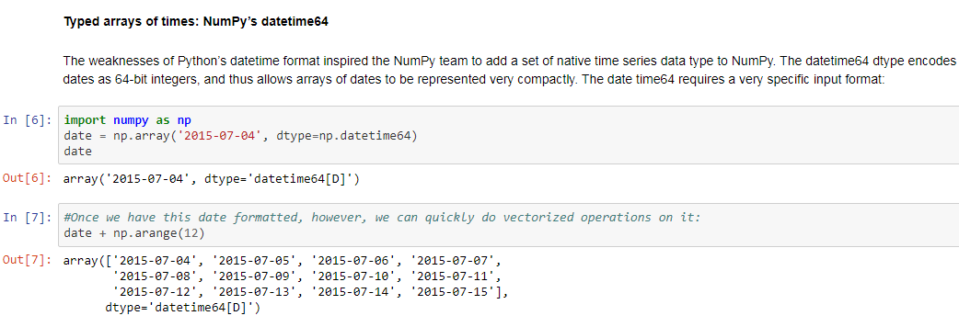

Slide 4
Pandas-Timestamp object
While the datetime64 data type (NumPy)addresses some of the deficiencies of the built-in Python datetime type, it lacks many of the convenient methods and functions provided by datetime and especially dateutil( a 3rd party tool).
Pandas builds upon all the tools just discussed to provide a Timestamp object, which combines the ease of use of datetime and dateutil with the efficient storage and vectorized interface of numpy.datetime64.
From a group of these Timestamp objects,Pandas can construct a DatetimeIndex that can be used to index data in a Series or DataFrame.
Pandas
import pandas as pd
date = pd.to_datetime(“26th of July, 2022")
date

Slide 5
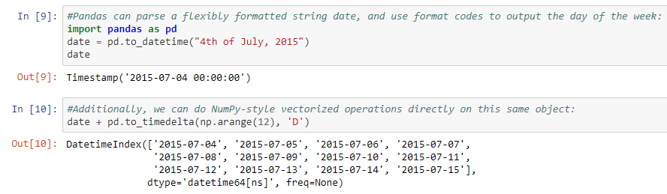

Slide 6
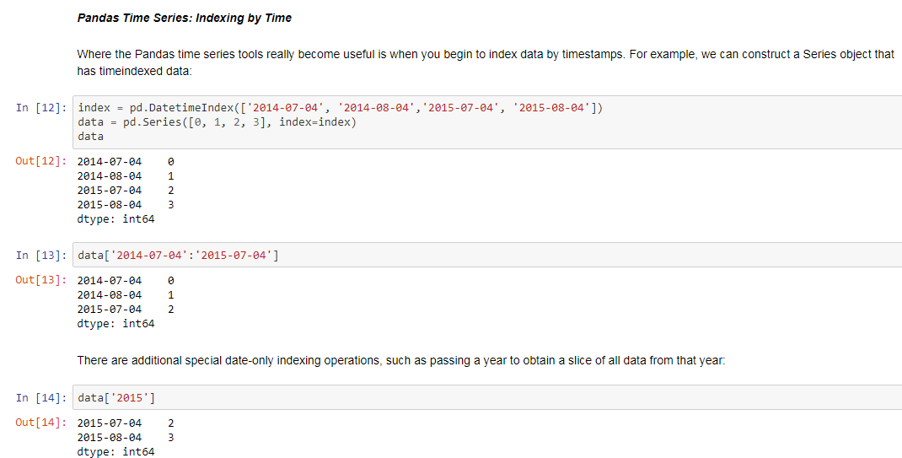

Slide 7
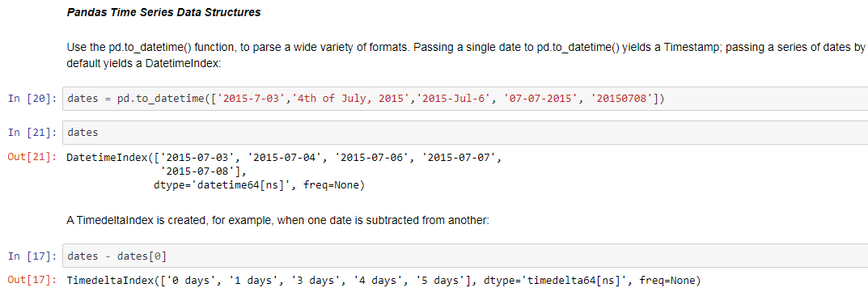

Slide 8
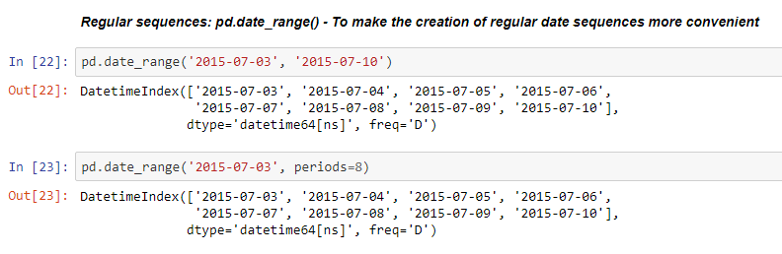

Slide 9
Lab Ex TimeSeries1-date structures.ipynb

